Slide 1
Case Study 2
Randy Kim

Slide 2
Agenda
Identify the top factors of attrition.
Further exploratory data analysis.
Predict attrition and salary.

Slide 3
Data Set
In given data, there were no missing values.
Total of 879 observations and of the total, 36 variables.
27 numeric
9 Categorical
Notes:
Eliminated 3 columns, Over18 (Y), Employee count (1) and standard hours (80).
No missing values.

Slide 4
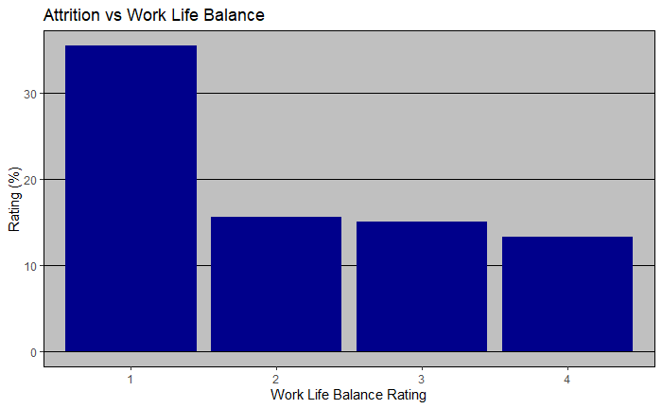
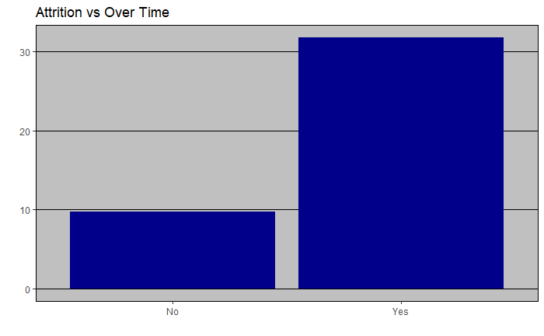
Top Factors on Attrition
Job Involvement
Overtime
Work life balance

Slide 5
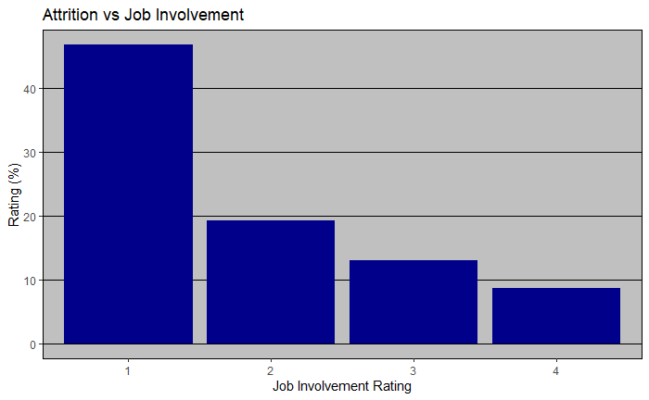
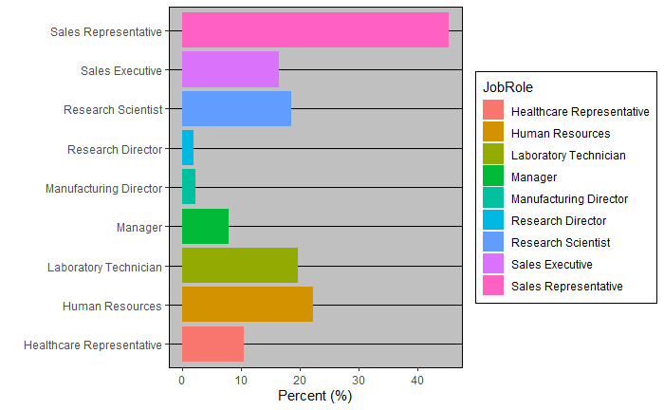
Top Factors on Attrition

Slide 6
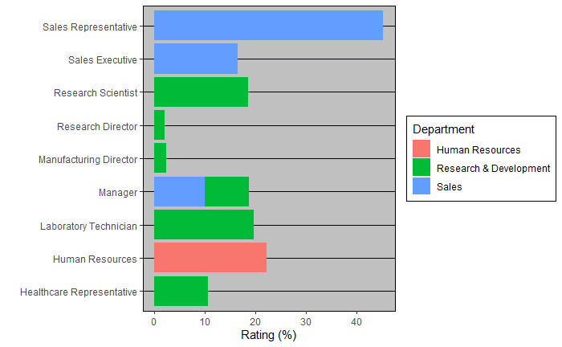
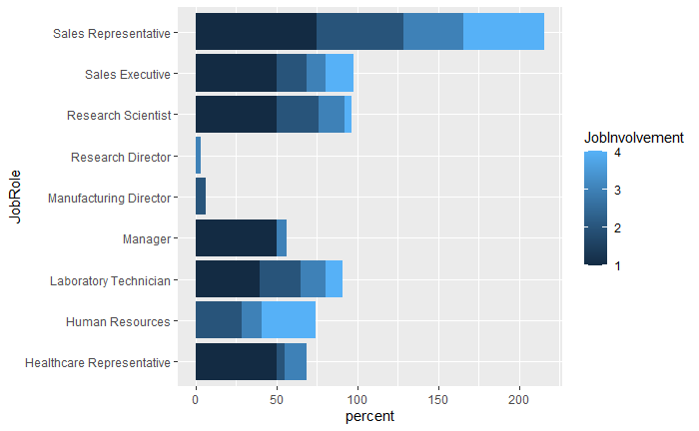
Top Factors on Attrition

Slide 7
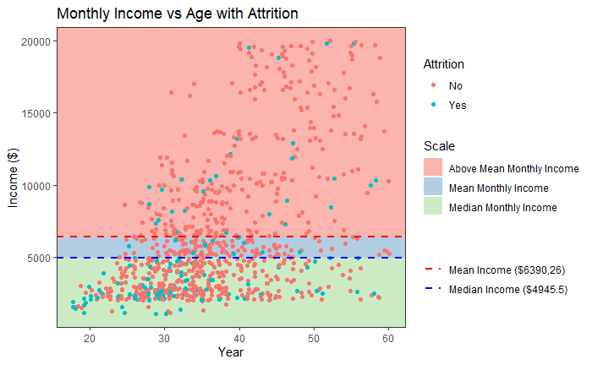
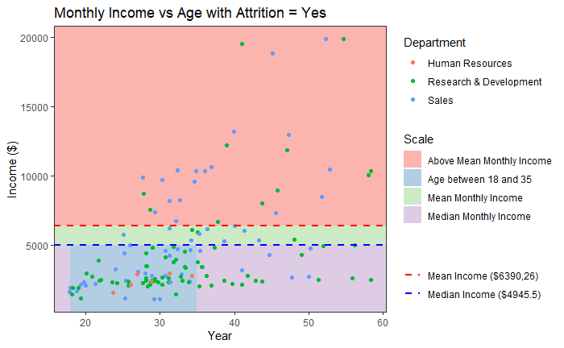
Continue

Slide 8
Attrition Prediction Model
Naïve Bayes Model
Job Involvement
Work Life Balance
Over Time
Job Role
Highest Accuracy: 91.57%
Average Accuracy = 85.79%
Average Sensitivity = 86.76%
Average Specificity = 69.0%
Notes:
P-value

Slide 9
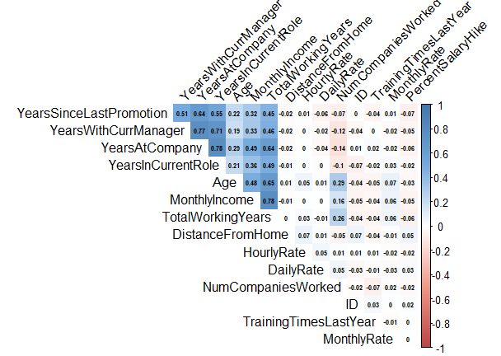
Correlation with Monthly Income
Correlation with Monthly Income
Monthly Income vs Total Working years : 0.78
Monthly Income vs Years At Company : 0.49
Monthly Income vs Age : 0.48

Slide 10
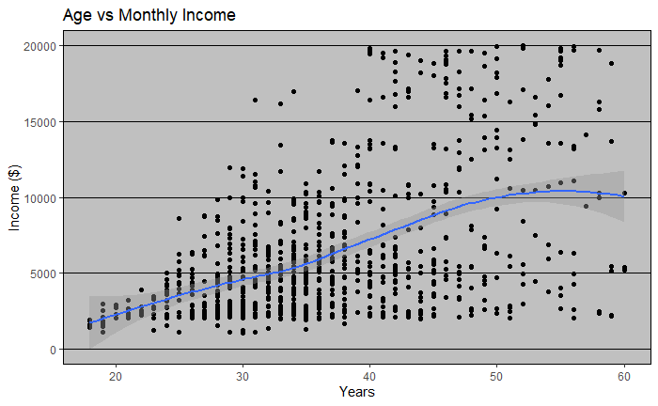
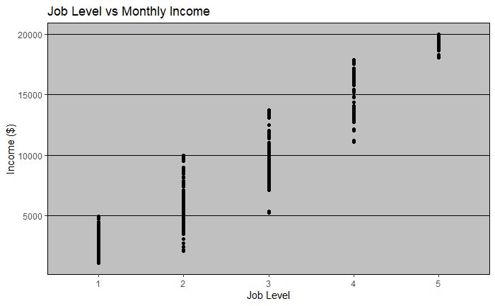
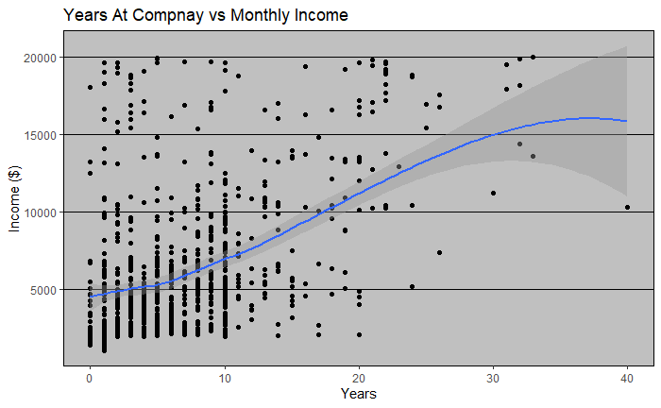
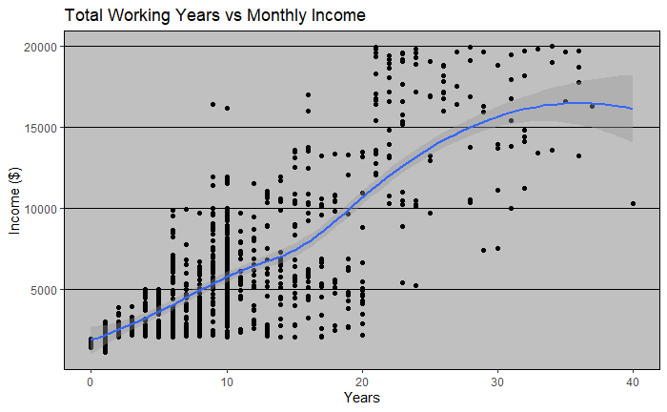
Correlation with Monthly Income

Slide 11
Salary Prediction Model
Linear Regression Model
Total Working Years
Years at Company
Job Role
Job Level
Age
RMSE
Average RMSE : 1017.17
P-value <2.2e-16
Adjusted R-square: 0.9505
Notes:
Add p-value

Slide 12
Link
Github:
https://github.com/RandytheReindeer/DDSCaseStudy02
Youtube:
https://www.youtube.com/watch?v=mcaI5FaE5eQ&ab_channel=RandytheRaindeer

